Slide 1

House price prediction

Slide 2
Questioning the data
Hypothesis:
Price of the house roughly increases with increase in sqft_living.
Price of the house roughly increases with increase in sqft_lot, as people generally would like to pay more to have more area around the house.
Waterfront houses cost generally more than non-waterfront ones.
As the house gets old its price roughly drops.
Questions:
How far do the condition and grade influence the price of the house?
Are there any exclusive neighbourhood (zipcodes) where the prices are just high and other factors don’t influence the price that much?

Slide 3
Types of attributes
Categorical data:
id, date, bedrooms, bathrooms, floors, waterfront, view, grade, yr_built, yr_renovated, zipcode, lat, long.
Numerical data:
Price, sqft_living, sqft_lot, sqft_above, sqft_basement, sqft_living_above, sqft_lot_below.

Slide 4
Conclusions from EDA
Univariate analysis:
Our target variable price with large amounts of outliers and it right skewed.
sqft_living is right skewed with large values and range
sqft_living15 is also right skewed with large values and range
Variable bedrooms mostly lie between 1&5, with some outliers and one very absurd observation of 30.

Slide 5
Byvariate analysis:
sqft_living increases , price increases roughly.
The sqft_lot and price of the house show very little relation.
We observe that the houses with a waterfront have on an average very high price compared to a house with no waterfront.
We also observe that as the number of views increases the average prices of the house increases.
The year the house was built has almost no relation to its price.
The average price of the house increases with increase in its grade.
There are two zipcodes 98039 & 98004 which have really high prices on an average and on median when compared with other zipcodes.

Slide 6
Unexpected results

Slide 7
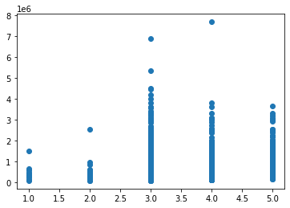
The house price doesn’t increase with increase in the condition of house, surprisingly.
The prices of the house with condition 3 are higher .

Slide 8
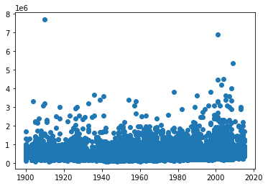
Surprisingly, The year the house was built has almost no relation to its price.
Also the mean of the prices at each year tend to be almost same.

Slide 9
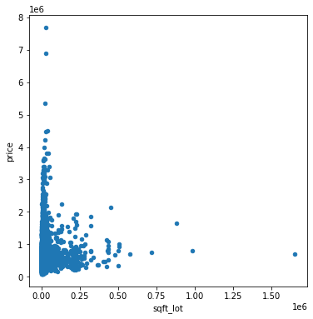
sqft_lot shows very low correlation with our target price, quite opposite to our hypothesis that people would like to pay more to have more area around the house.

Slide 10
Initial model fitting
Model 1:
X(predictors)=[‘sqft_living’,’bathrooms’,’view’]
REASON:
As these variables show high correlation with our target price (sqft_living shows corr=0.76) and they show low correlation among themselves.

Slide 11
Initial model fitting
Model 2:
X(predictors)=[‘ Grade’, ‘bedrooms’, ‘Sqft_living15 ‘]
REASON:
The predictor grade has very good relation with our target and the other variables also show good correlation with price. Also the correlation among themselves is low.

Slide 12
RESULTS FROM 10-FOLD CV:
MODEL1:
RMSE_cv_score=257100.74
R2_cv_score=0.532
MODEL2:
RMSE_cv_score=275846.761
R2_cv_score=0.464
This shows that both of our models did not perform well as the RMSE score is very high and our predictors of model1,model2 explain only 53.2% & 46.4% of the variation in our dependent variable respectively.

Slide 13
Feature engineering

Slide 14
Feature Transformation
Log Transformation:
We add new columns with log transformations to our original data for:
Variables=[sqft_living,sqft_living15,sqft_above] as these variables show high spread and are right skewed, with no values being 0.
Log transformation is done on these variables to reduce its spread and skewness.
Square root transformation:
We add new columns with squareroot transformations to our original data for the variable ‘sqft_basement’ as it has 0 value in it and we would also like to reduce its spread.
Date column:
We extract the year from the column ‘date’ and transform that column so that we can find the age of the house afterwards in the feature generation technique.

Slide 15
Feature generation
Age:
We create a new column named ‘age’ as:
dataframe[‘age’]=dataframe[‘date’]-datframe[‘yr_built’]
we just subtract yr_built from date for each observation and get age of the
house.
DUMMY VARIABLES:
There is only one nominal variable ‘zipcode’ for which there are 70 unique values which would result in 69 dummy variables , so we avoid this step.

Slide 16
Model fit part 2

Slide 17
Model 1:
X=[‘log(sqft_living)’, ‘bathrooms’, ‘view’, ‘age’]
(adding our new column ‘age’ and the transformed feature ‘log(sqft_living)’)
Model 2:
X=[‘log(sqft_living15)’, ‘grade’, ‘bedrooms’, ‘age’]
(adding our new column ‘age’ and the transformed feature)
RESULTS FROM 10-FOLD CV:
MODEL1:
RMSE_cv_score=272875.02
R2_cv_score=0.474
MODEL2:
RMSE_cv_score=258151.94
R2_cv_score=0.5309
The results did not change very much from our previous models after feature engineering and selecting our predictors manually.

Slide 18
Model fit part 3

Slide 19
Backward elimination
Step 1:
Considering all the attributes:
X= ['bedrooms', 'bathrooms', 'floors’, log(sqft_living),sqft_lot,'waterfront’, 'view','condition', 'grade', ‘log(sqft_above)', ‘sqrt(sqft_basement)’, 'lat’,'long’,'log(sqft_living15)’, sqft_lot15,'age’]
Step 2:
Dropping the columns with p value greater than 0.05.
The predictors ‘sqft_lot15’ and ’floors’ show p>0.05 hence they are removed and step 1 is repeated. This is done until all the predictors with p>0.05 are eliminated.

Slide 20
Backward elimination
Step 3:
Considering the remaining variables after all predictors with p>0.05 are eliminated .
X_final=
Step 4:
RESULTS FROM 10-FOLD CV FOR SFS MODEL:
RMSE_cv_score=217481.52
R2_cv_score=0.666
['bedrooms', 'bathrooms', 'log(sqft_living)', 'sqft_lot', 'waterfront', 'view', 'condition', 'grade', 'log(sqft_above)', 'sqrt(sqft_basement)', 'lat', 'long', 'log(sqft_living15)', 'age']

Slide 21
Forward selection
Using mlxtend library :
from mlxtend.feature_selection import SequentialFeatureSelector as sfs
clf=LinearRegression().fit(X,y)
sfs1 = sfs(clf,k_features=6,forward=True, floating=False,
verbose=2,scoring='r2',cv=5)
This gives us a set of 6 predictors which are the best ranking predictors for our regression based on the scoring R2.
The predictors are:
X=['bathrooms’, 'waterfront’ , 'view’ ,’grade’, 'lat’, 'age']

Slide 22
RESULTS FROM 10-FOLD CV FOR SFS MODEL:
RMSE_cv_score=226121
R2_cv_score=0.6393

Slide 23
Model fitting part 4

Slide 24
Decision tree
Model 1:
Selecting predicters we got from forward elimination through LR.
X=['bathrooms','waterfront','view','grade','lat','age’]
HYPERPARAMETERS:
selecting max_depth=5 , min_samples_leaf=5
RESULT:
RMSE_cv_score=221911.5523
R2_cv_score = 0.6491

Slide 25
Decision tree
Model 2:
Selecting predicters we got from backward elimination through LR.
X=[‘bedrooms', 'bathrooms', 'log(sqft_living)', 'sqft_lot', 'waterfront',
'view', 'condition', 'grade', 'log(sqft_above)', 'sqrt(sqft_basement)',
'lat', 'long', 'log(sqft_living15)', ‘age’]
HYPERPARAMETERS:
selecting max_depth=5 , min_samples_leaf=5
RESULT:
RMSE_cv_score=210171.306
R2_cv_score = 0.6896

Slide 26
Model 3:
In this model lets consider all the predictors with the transformed features and do forward selection based on decision tree , with scoring=RMSE.
We use the same library mlxtend to do this, which returns us 6 best features to perform our decision tree on. The features are:
X=[‘log(sqft_living)','sqft_lot','waterfront','grade','lat','long’]
We perform decision tree algorithm on this set of predictors with the hyperparameters: max_depth=5 , min_samples_leaf=5
RESULT:
RMSE_cv_score=197460.268
R2_cv_score =0.7229

Slide 27
SELECTING THE BEST MODEL FOR TESTING
From all the models we fit on our training data and reported our RMSE and R2 values using 10-fold CV, only two models stand out based on these performance metrics compared to others .
Those are:
1)Forward selection through LR.(scoring=‘r^2’)
X=['bathrooms','waterfront','view','grade','sqft_above','lat','age’]
RMSE=226121.46
R2=0.6393
2)Forward selection through decision tree(scoring=‘RMSE’)
X=[‘log(sqft_living)','sqft_lot','waterfront','grade','lat','long’]
RMSE= 197460.268
R2=0.722
Lets use these models and their respective set of predictors on the test data and report our results.

Slide 28
Testing

Slide 29
Model 1 for Testing:
X=['bathrooms','waterfront','view','grade','sqft_above','lat','age’]
applying Linear regression we get:
RESULT:
RMSE_cv_score=207947.063
R2_cv_score = 0.6636

Slide 30
Model 2 for Testing:
X=[‘log(sqft_living)','sqft_lot','waterfront','grade','lat','long’]
applying Linear regression we get:
RESULT:
RMSE_cv_score=178628.472
R2_cv_score = 0.7518

